Slide 1
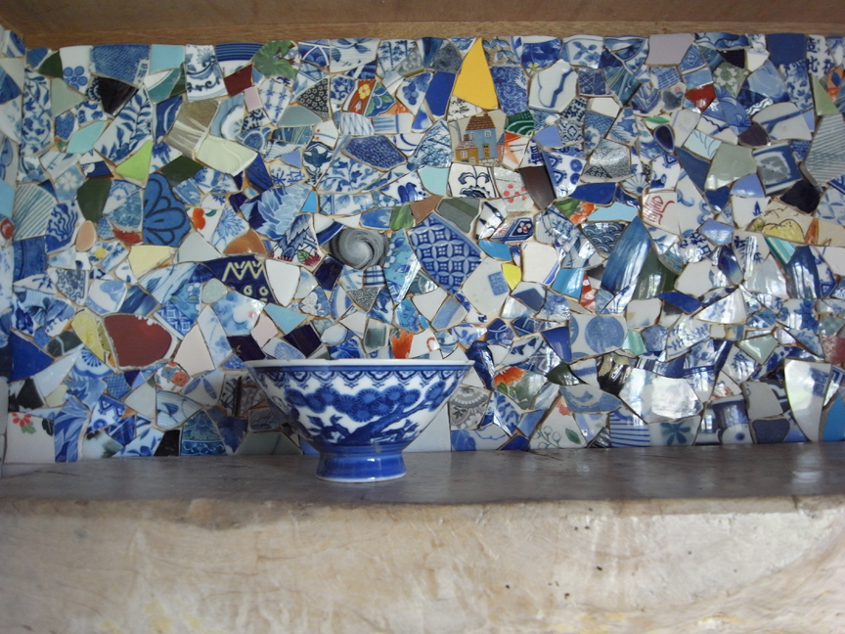
The Elements of Art

Slide 2
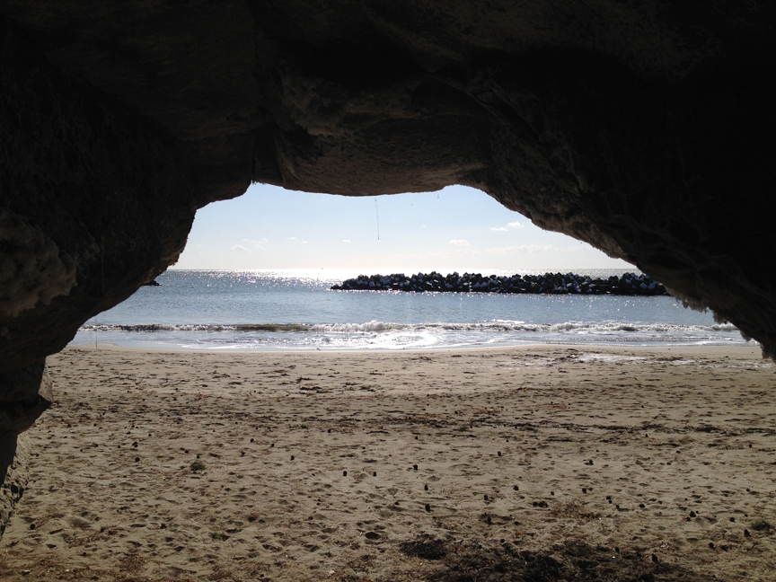
The elements of art are the building blocks of art creation. They are found everywhere in our environment, not just in artwork. They are a part of the created order, some of the “laws” God set in place to help us visually organize what we see.

Slide 3
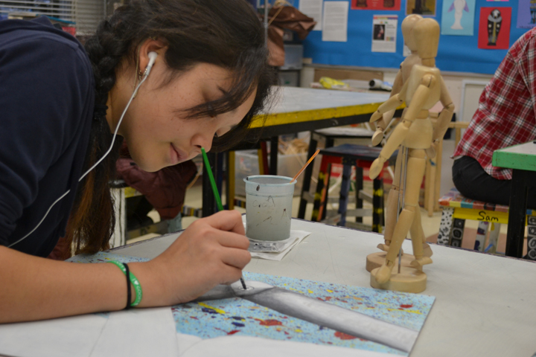
God created the world with these elements in place. They help us make sense of what we see in the world around us. He has also made us with the capacity to create using these elements, along with the tools, materials and creative minds he has given us.

Slide 4
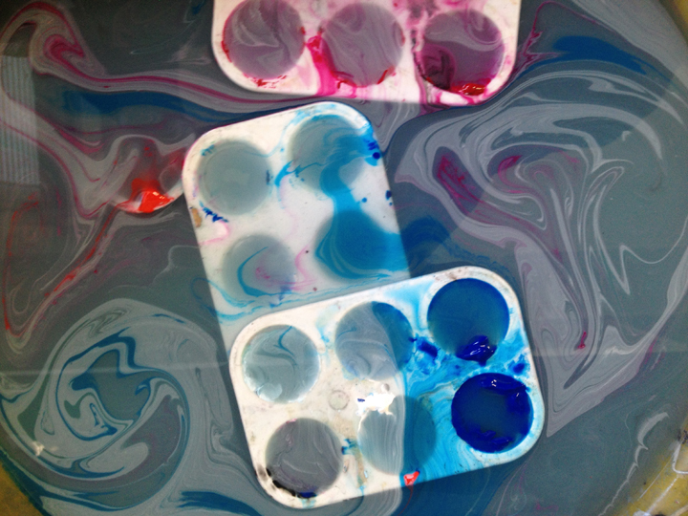
What art the elements of Art?
The elements of art are the “ingredients” that artists use to make art. There are 7 of them:
Line
Value
Shape
Form
Color
Texture
Space

Slide 5
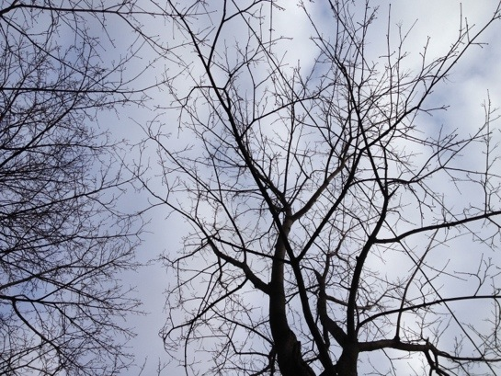
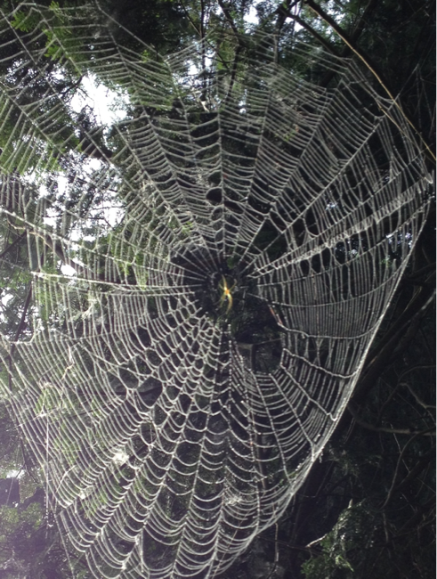
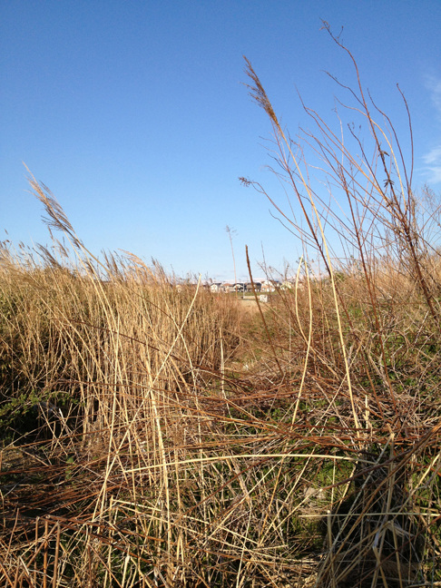
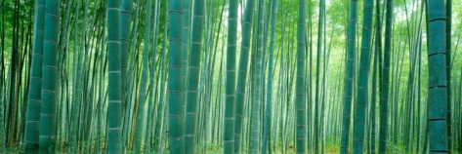
In nature, lines can be seen as tree branches, cracks in rocks, grasses, flower stems, etc.

Slide 6
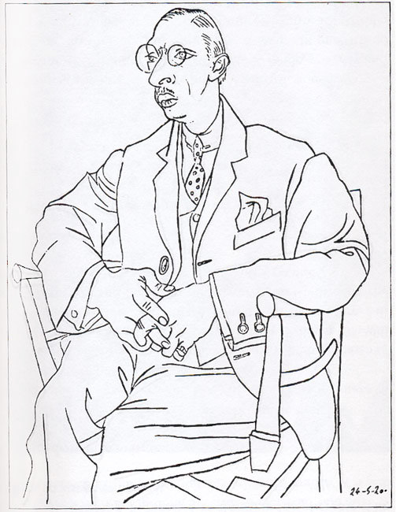
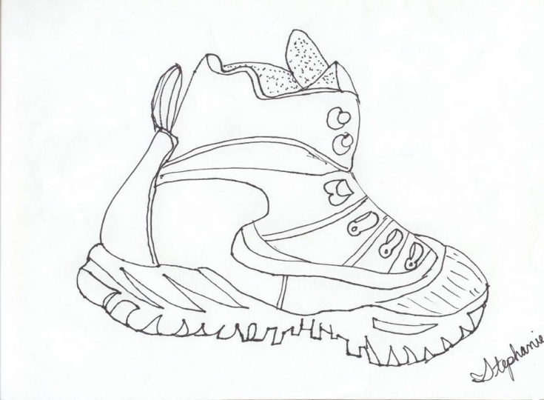
Contour lines indicate the edges of forms or shapes and describe them in the simplest way.

Slide 7
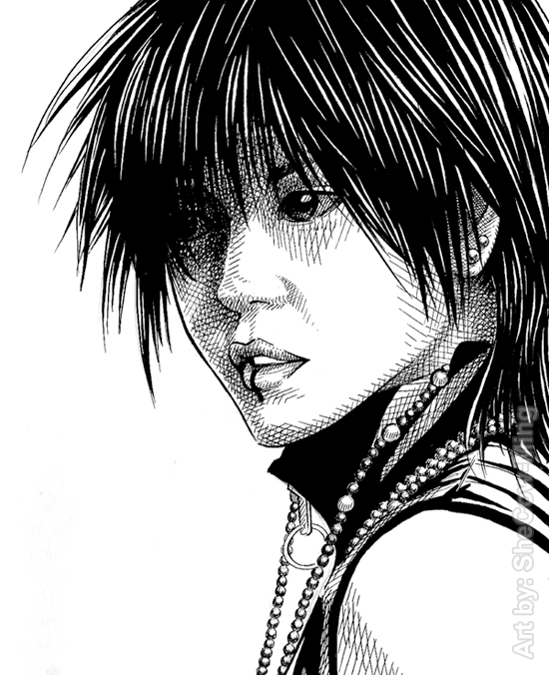
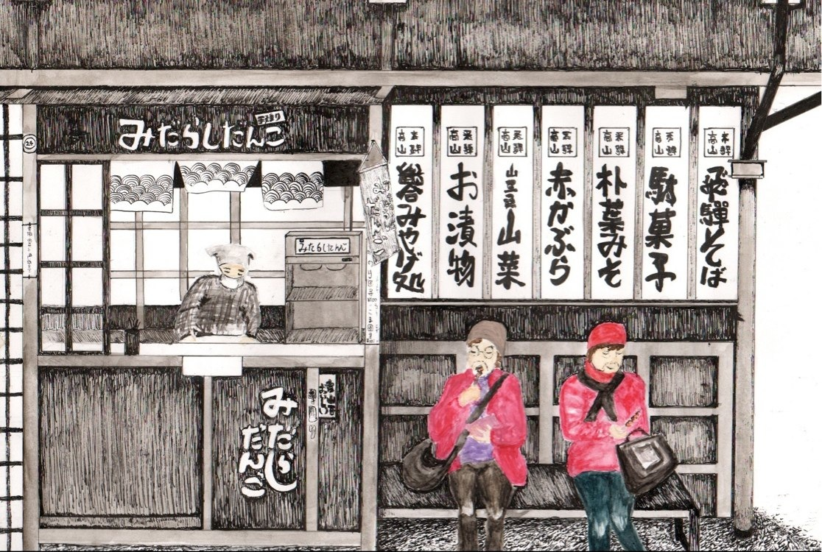
Lines can be used to create values and textures. Hatching is the placing of many lines next to each other. Cross-hatching occurs when many parallel lines cross each other.

Slide 8
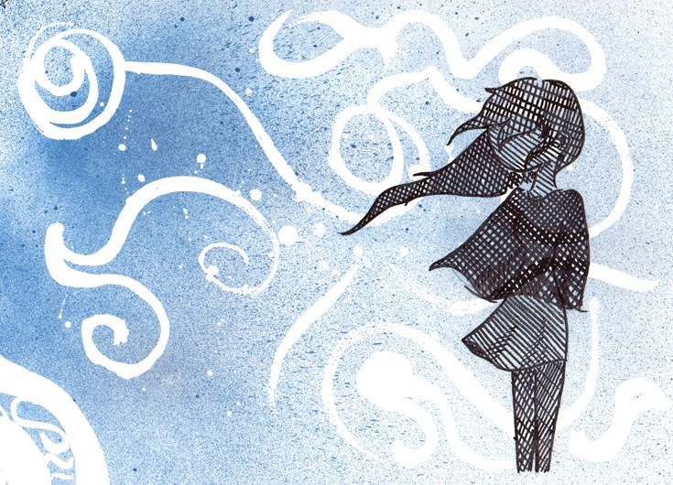
Gestural lines indicate action and physical movement. Our eyes follow the active lines as they swirl across the page.

